Slide 1


ME 570 Project Presentation
Real-time point cloud capture and comparison for a 3D printing process
Ankush Kumar Mishra

Slide 2
Goal
Framework to capture the point cloud information of a 3D printing process and comparison with a simulated point cloud of the process.
Filtering
Point Cloud Registration
Point Cloud Comparison
Generating simulated point cloud of the process
The difference in results to be used for qualitative characterization of geometric aspect of the product being manufactured.
Notes:
Page fades in, red pops up. Only this page

Slide 3
Vision
Real time comparison of the 3D printing process
Notes:
Page fades in, red pops up. Only this page

Slide 4
Manufacturing Bed Setup
MAKERGEAR M2 Printer
Nozzle dia – 0.35 mm
ABS Material
Intel RealSense D 435 Camera
Stereo vision depth technology
Error – 0.2 mm at a distance of 300 mm
Notes:
Page fades in, red pops up. Only this page

Slide 5
Manual Point Cloud Filtering
Notes:
Page fades in, red pops up. Only this page

Slide 6

Simulated Point Cloud
Voxel model generation from the CAD model algorithm¹.
Generation of G-Code for 3D printing and voxel printing file for simulated point cloud.²
Simulated Point Cloud
G. Young, A. Krishnamurthy, Gpu-accelerated generation and rendering of multi-level voxel representations of solid models, Computers & Graphics 75 (2018) 11–24
S. Ghadai, A. Jignasu, A. Krishnamurthy, Direct 3d printing of multi-level voxel models, Additive Manufacturing 40 (2021) 101929.
Notes:
Page fades in, red pops up. Only this page

Slide 7
Results
The image captured using only one camera. The maximum deviation is up to 6 mm.
Notes:
Page fades in, red pops up. Only this page

Slide 8
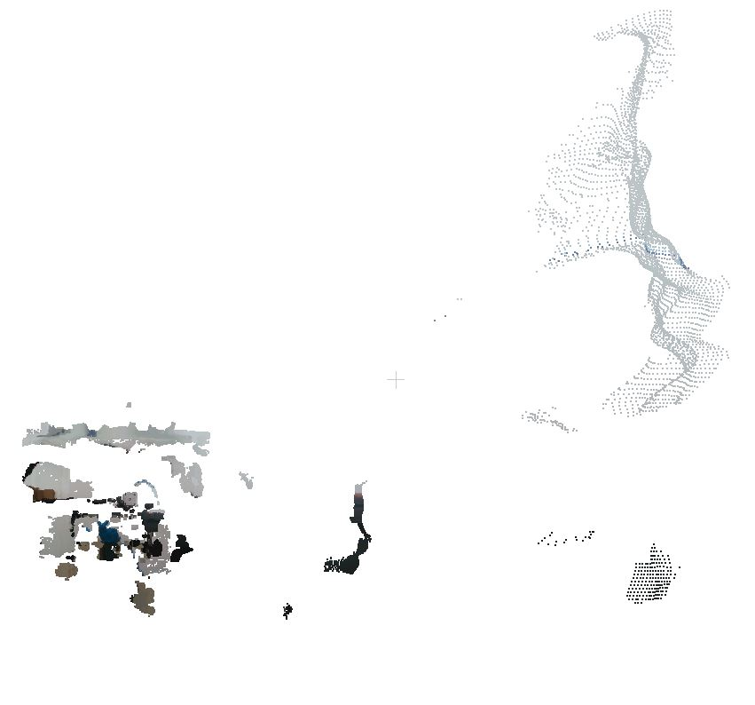
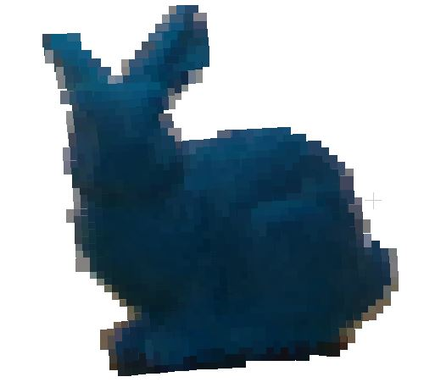
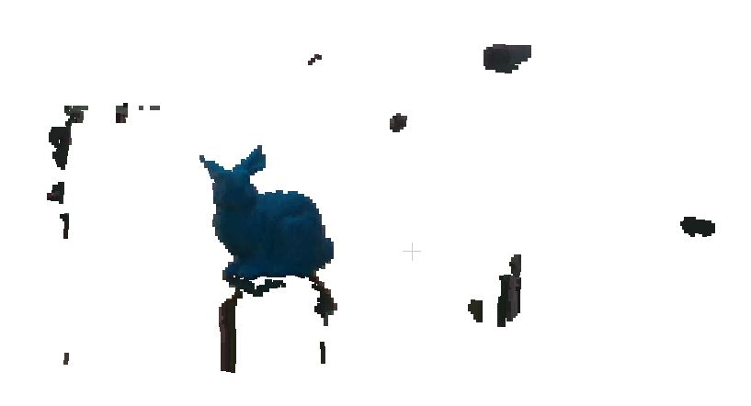
Ongoing Work: Automated Point Cloud Filtering
Raw Point Clou
Manually Filtered Point Cloud
Filtered using Distance Mask and average RGB mask
The framework is being develop to do a real-time comparison
Notes:
Page fades in, red pops up. Only this page

Slide 9
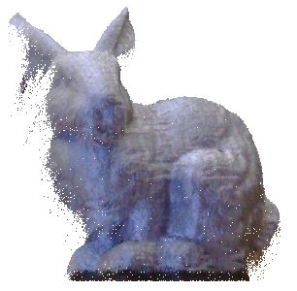
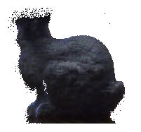
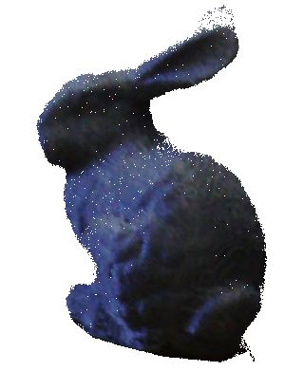
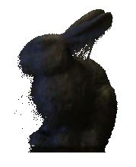
Ongoing Work: Cloud comparison using FARO focus Laser Scanners
Front View
Back View
Left Side View
Right Side View
Notes:
Page fades in, red pops up. Only this page

Slide 10
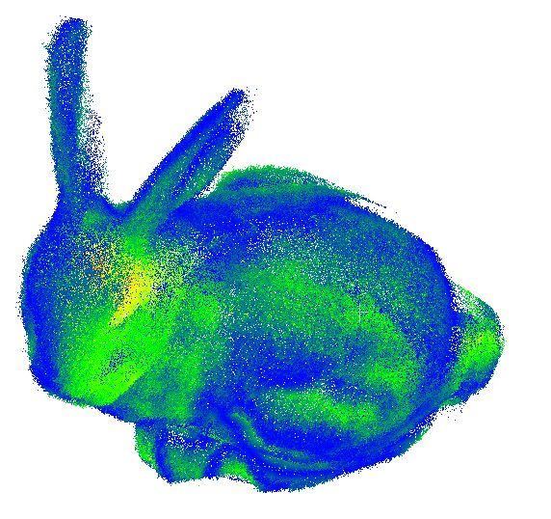
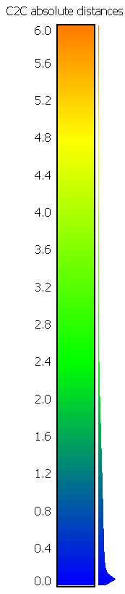
Results
Comparison results after registration of four views
Notes:
Page fades in, red pops up. Only this page

Slide 11
Thank You
Notes:
New names

